Slide 1
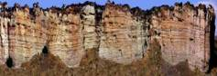
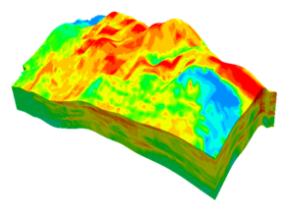
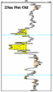
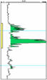
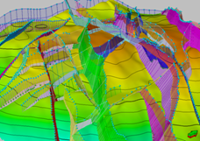
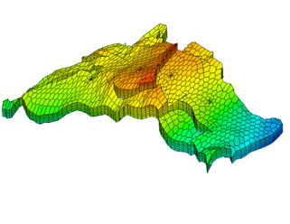
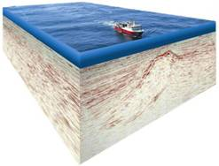
Integrated Model
Stratigraphy
Rock & Fluid Properties
Geologic Model
Petrophysics, Rock & Fluid Properties
80000
OIL
60000
Production Rate
Seismic Attributes
(STBPD)
40000
WATER
Production Data
20000
0
0
5
10
15
20
Year
Structure
Flow Simulation
Seismic
History Matching
Notes:
Overall picture of current exploration/development production process
Old linear way Geophysicist>Structure, Geologist>Sand if discovery, throw it over the wall to engineer
In reality, often iterative, with cycles of updates, 4D, drill a well, update all steps.

Slide 2
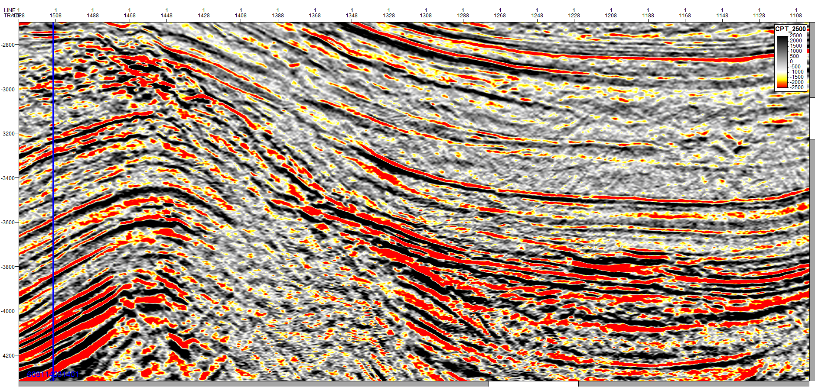
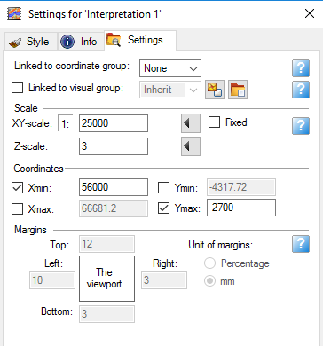
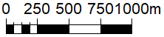
Structural Seismic Interpretation
Notes:
This is the “Why I care Slide”
Old days: seismic for structure, then 80’s seismic stratigraphy, depositional patterns, DHIs
Now: Quantitative Seismic Interpretation trying to get as much information about rock properties and fluids as possible.
This> Seismic section is from Green Canyon near the 1st 3D project you’ll be working on.
In Depth (talk about in later lectures), point out structure, lower salt, fault, scale, vertical exaggeration …
Pitfall & Pet Peeve
What’s wrong with this display?
> It’s displayed too hot. You’ll see this a lot. It’s fine for structural interpretation but it hides most of the information in the data.
For example, say this is your target horizon; from this display it looks pretty consistent until it onlaps.
Click:
T
his is a histogram of the amplitudes of our target: 1300 to 13000.
Our current color scale tops out at 2500 (green arrow) so 3000 looks like 13000.

Slide 3
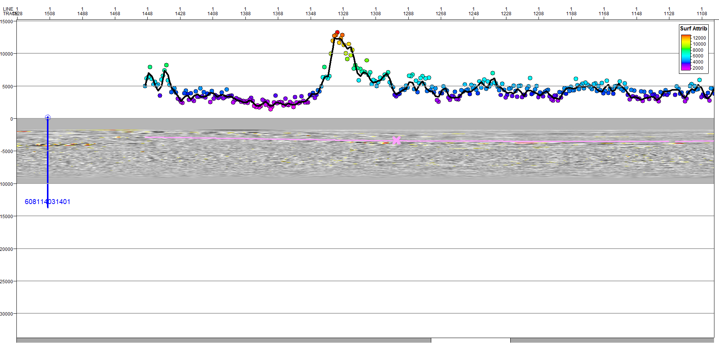
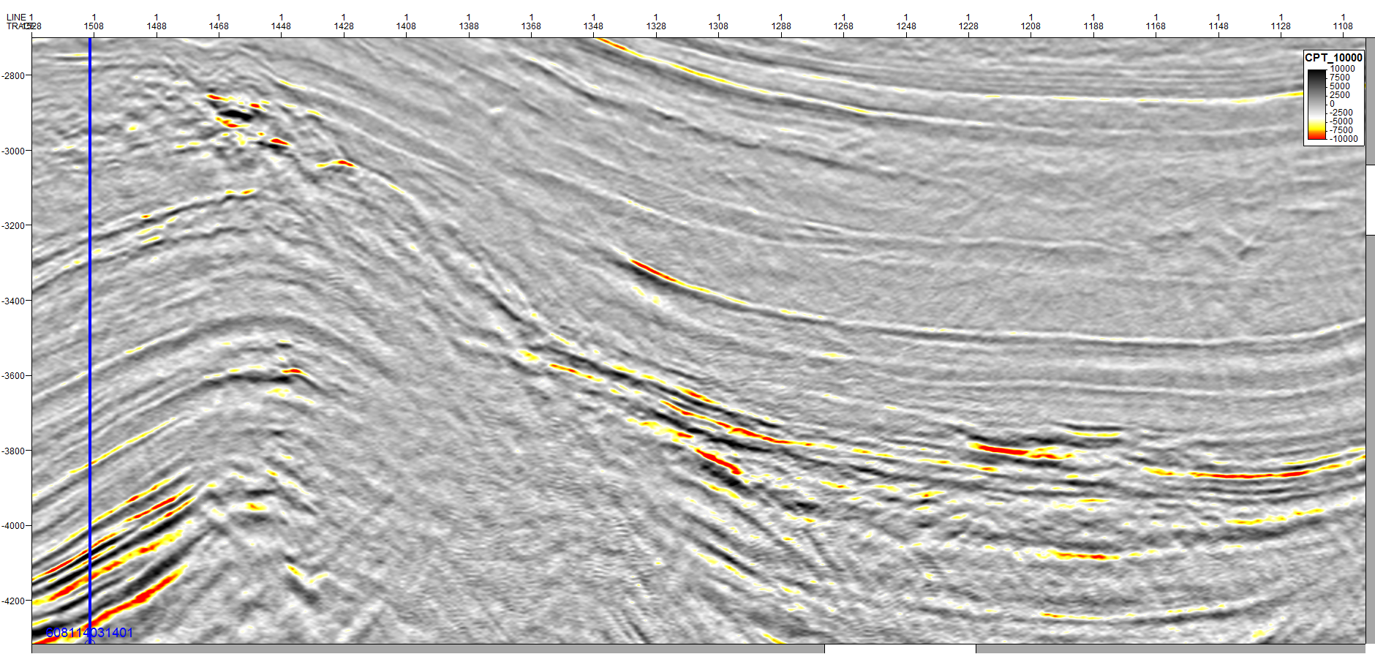
Quantitative Seismic Interpretation
12500
4500
2000
I² - I¹
RC = ---------- I² + I¹
Notes:
This is the same section with a more appropriate scale
Now we can see much more detail, huge amplitude change on target before onlap
Point out other high and low amplitudes
Click:
If we measure the amplitudes we can see the magnitude of the change: 4K to 12K 300%
After onlap, 2K 50%, different lithology.
This is the start of quantitative interpretation.
The big question is what do these amplitudes mean: lithology change, hydrocarbons, thickness change?
That’s what the rest of this lecture is about: understanding the rock properties which create seismic amplitudes.
So that we can translate the seismic information into something we care about like reservoir and fluid properties.

Slide 4
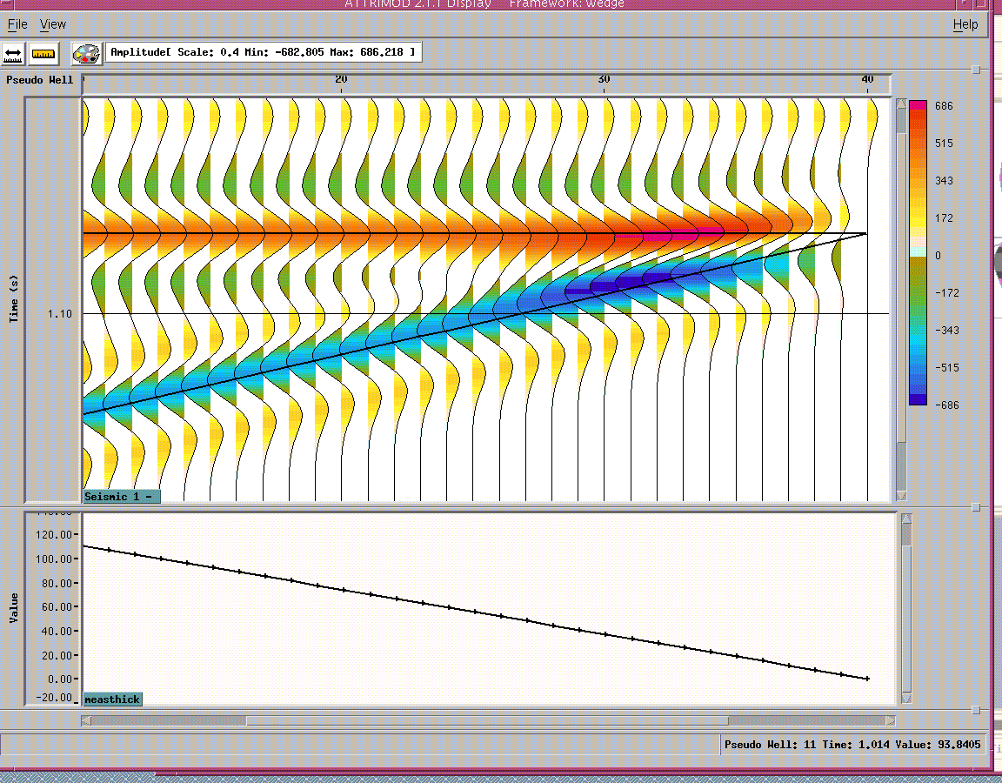
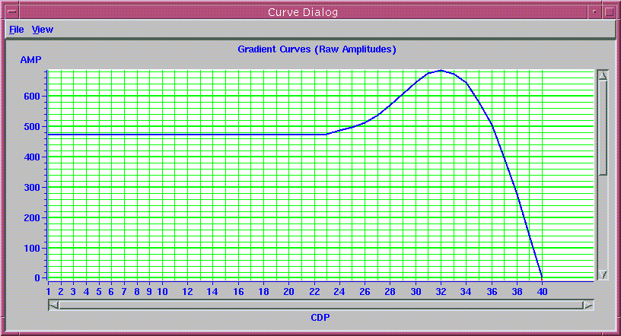
Can I predict Reservoir Presence and Quality?
360’
125’
0’
Wedge Model
(20 Hz Ricker - 10000 f/s)
Period = 1 / 20 = .050 sec
λ_{d} = .050 x 10000 = 500 ft
∼ λ_{d} /4
Amplitude of Top Reflection
Notes:
What we care about is how different are the properties of hydrocarbons and water. The greater the difference, the greater the change in reflection amplitude.
EXPLAIN SLIDE

Slide 5
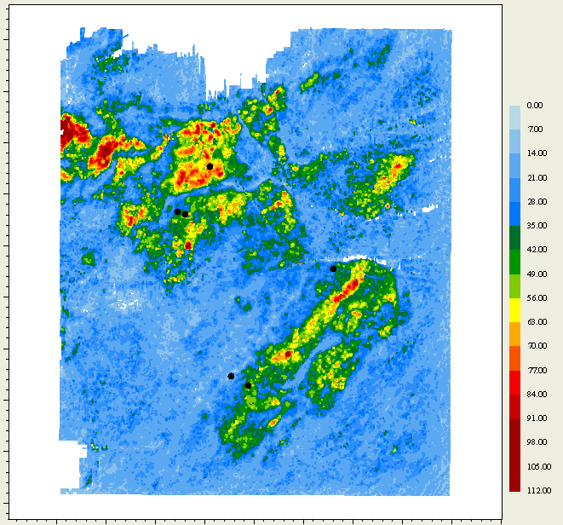
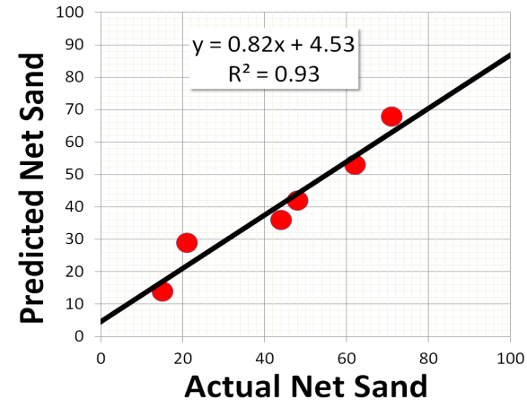
Can I predict Reservoir Presence and Quality?
Predicted net sand map
generated from model based seismic attribute analysis and calibration.
Predicted Net Sand – Interval A
Well B
Well E
Well C
Well F
Predicted Net Sand (ft)
Well
Net Sand
Pred.
Well B
71
68
Well E
21
29
Well D
Well A
Well C
48
42
Well A
62
53
Well D
15
14
Well F
44
36
Notes:
A couple examples of what we’re trying to accomplish:
Seismic amplitudes can have information on lithology - quantity and quality of reservoir for example.
This is a brief example. We won’t be covering the details but, DEPENDING ON CONDITIONS; reservoir extent, quality and thickness can be accurately predicted from seismic without wells.
EXAPLAIN Map
Predicted Net Sand, Interval A
Wells, Color Bar (pred. sand 0-112’), Scale, North Arrow
Process:
Interpreted seismic, extracted attributes, correlated attributes to net sands in wells, applied relationship to attributes, net sand map.
Table and graph of results: pretty good correlation.

Slide 6
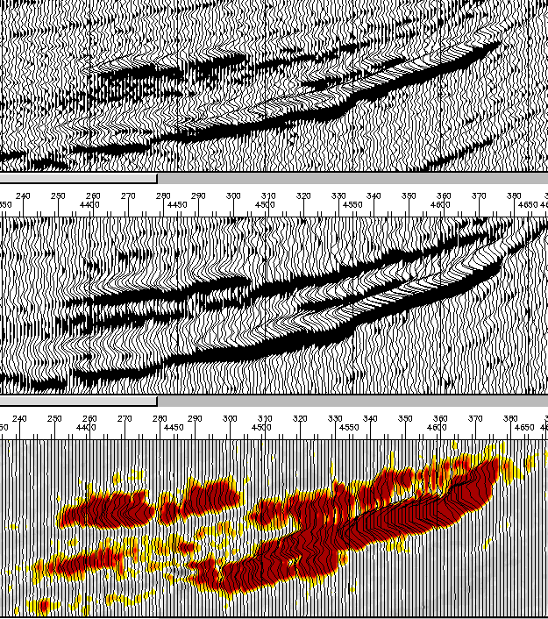
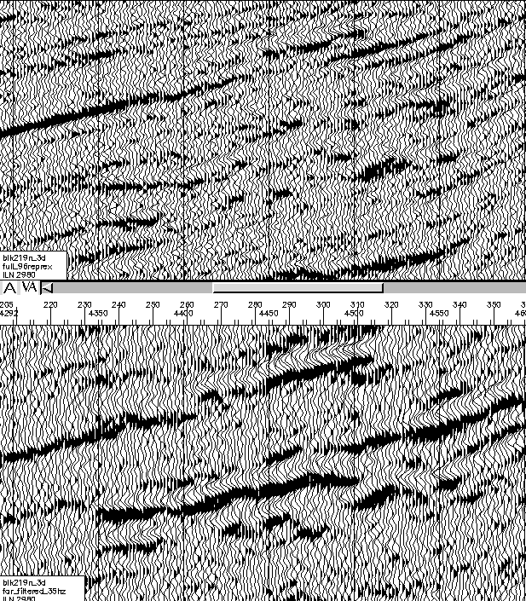
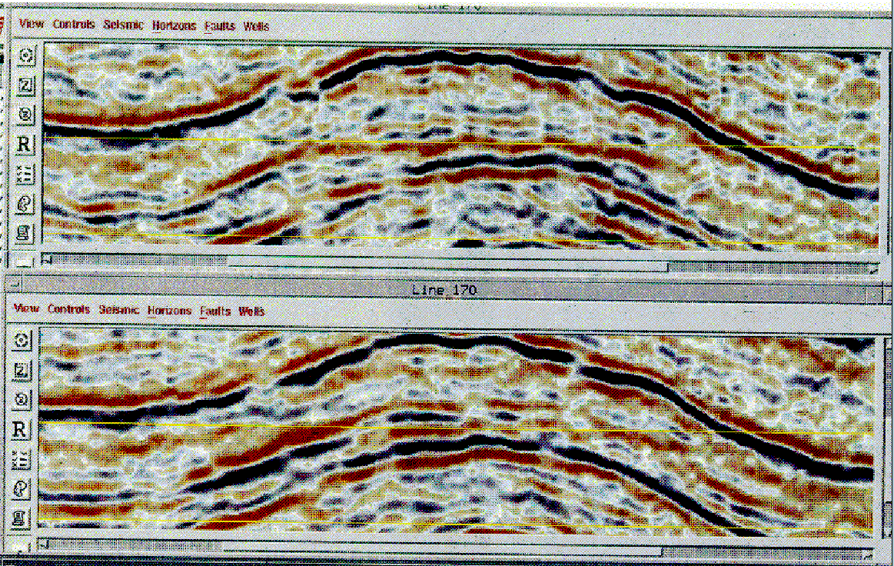
Fluid Type: What Kind of Response ?
DHI Classes - Stacked Seismic Data
Class III DHI
Strong, Brightening Low Impedance Reflection
How deep can I see hydrocarbons?
Where is my “DHI Floor” ?
Class II DHI
Weak Reflection
Class I DHI
High Impedance, Dimming Reflection
Fluid Contact
Rutherford and Williams, 1989
6
Notes:
Another example is understanding fluid response.
3 seismic sections illustrating 3 different hydrocarbons responses depending upon the rock properties
3 classes> Ruth & Will.
Class III
Class II > “DHI Floor”
Click:
Class I

Slide 7
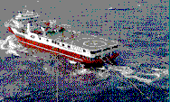


What controls Seismic Amplitudes?
Velocity (Pwave) V_{P}¹ Density (r¹)
Velocity (Pwave) V_{P}² Density (r²)
Reflectivity
Zero-offset reflection coefficient (RC) is a function of the impedance contrast between any two layers.
V_{P}¹, r¹
V_{P}^{2 *} r² - V_{P}^{1*} r¹ I² - I¹
RC = ----------------------------- = ---------- V_{P}^{2 *} r² + V_{P}^{1*} r¹ I² + I¹
V_{P}², r²
7
Notes:
What controls Seismic Amplitudes?
Since stacked data>Going to talk almost entirely about normal incidence impedance.

Slide 8
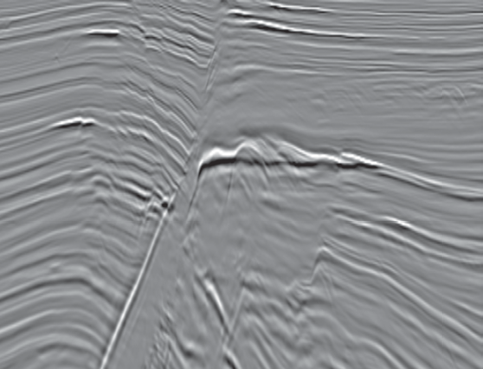
What controls rock velocity and density ?
Burial History: Effective Stress, Time and Temperature
Initial Deposition: Mineralogy, Grain Size, Texture
Digenetic History: Compaction , Cementation
Reservoir Conditions: Pore Fluid Properties, Pressure, Temperature
Reservoir Properties:
Quality, Fluid Type, …
Information on History,
Current Conditions, Production…
Output Parameters:
Velocity, Density, Poisson’s Ratio, Bulk Modulus etc.
Interpretation, Attributes, Inversion for Elastic Properties
Interpretation, Inversion for Elastic Properties
Rock Physics Model
Seismic Response
Notes:
What controls rock velocity and density?
Carefully go through slide

Slide 9
Factors that control rock velocity, density, seismic response
Reservoir Properties
Porosity
Lithology /Mineralogy/Clay Content
Grain Size, Sorting
Age, Stress History
Compaction, Consolidation History
Cementation
Anisotropy (layering, fracturing)
Total Organic Carbon (TOC)
Pore Shape
Temperature
Pressure
Thickness
Net/Gross (NTG)
Layer Geometry
Fluid Properties
Fluid Type
API Gravity (density)
Gas/Oil (GOR), Gas/Water Ratio
Saturation
Fluid Density
Brine Salinity
Viscosity
Wettability
Reservoir process
Production history
NTG = net formation thickness contributing
to oil and gas production/gross thickness of the formation
Notes:
There are a large number of factors that combined to determine the velocity and density of a given rock in a given spot.
GO THROUGH SLIDE
To understand amplitudes, we must understand as much as possible about these factors and what controls them.
If we understand these factors, then we can predict what kind of seismic response to expect.

Slide 10
Mineral Properties
Notes:
Start with constituent mineral properties
Explain plot: Porosity, P Velocity, lines of constant impedance
Carbonates
Quartz
Clays > Shales, significantly different
Special Cases: Salt, Kerogen (later, for unconventional)

Slide 11
General Rock Property Trends
Notes:
General Rock Property Trends
Dolomite, Anhydrite (Explain function of density / porosity)
Limestone
Sandstone
Shales

Slide 12
West Africa, Niobrara Properties
Notes:
Example real properties on top of trends.
Niobrara: Chalks & Marls, Shales
West Africa: Very different, much lower impedance, Shales, Water Sands, Oil Sands

Slide 13
North Sea Properties
Notes:
Start paying attention, North Sea example from your 2nd 3D project
Shales
Wet Sands
Oil Sands > Same impedance as shales > probably see dimming from water to oil, class II

Slide 14
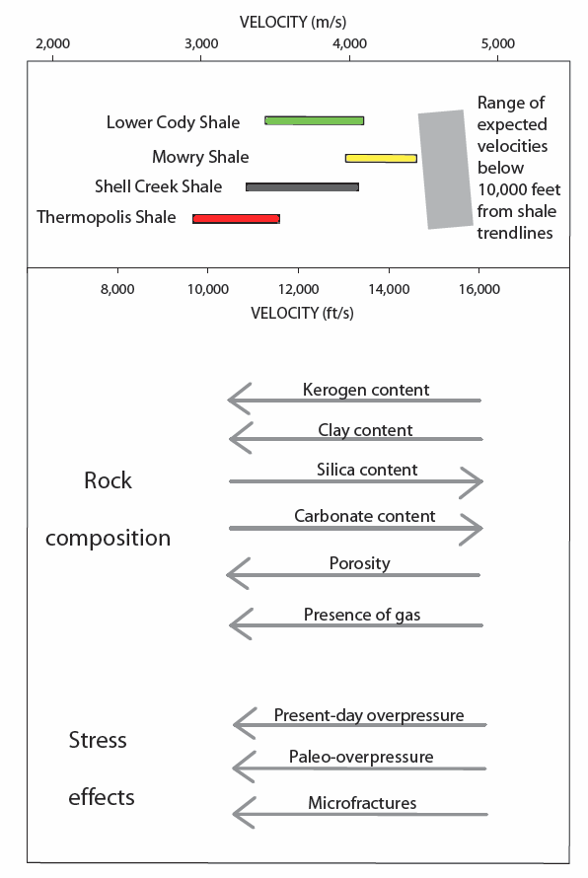
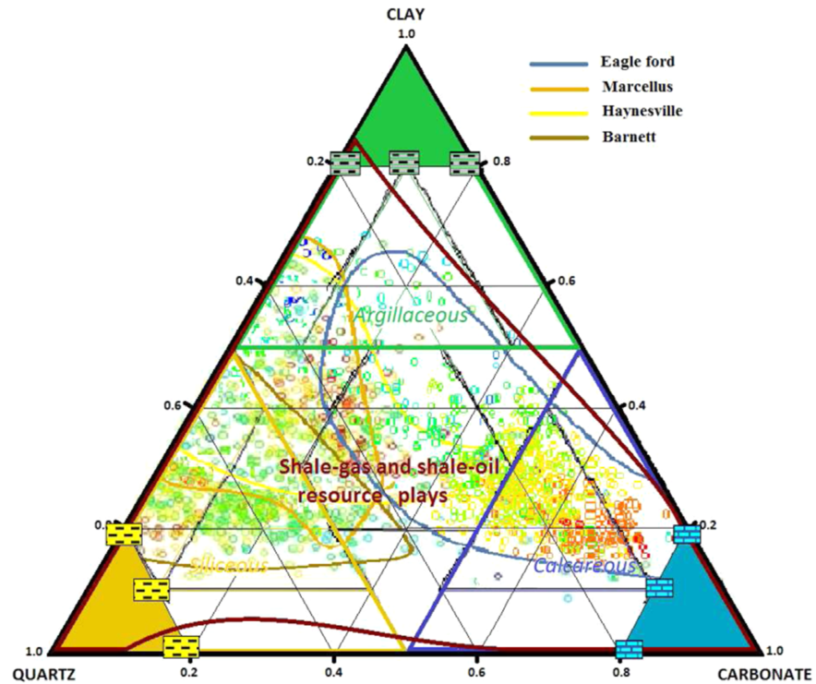
Unconventional Resources
Ternary diagram from mineral laboratory data
Nelson (2010)
Nicolás-López, Valdiviezo-Mijangos (2016).
Notes:
RIGHT:
Unconventional Resources
Ternary diagram from mineral laboratory data: Sand, Clay, Carbonate
Different plays are going to have very different properties depending on content:
Eagleford: Heavily carbonate
Marcellus: Mix of Quartz and clay
LEFT:
Top Bars (velocity scale)
General effects, go through, we’ll talk about some of these in more detail.

Slide 15
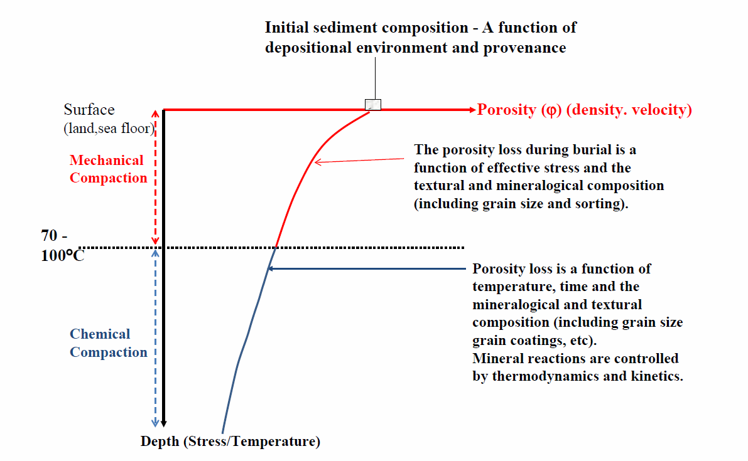
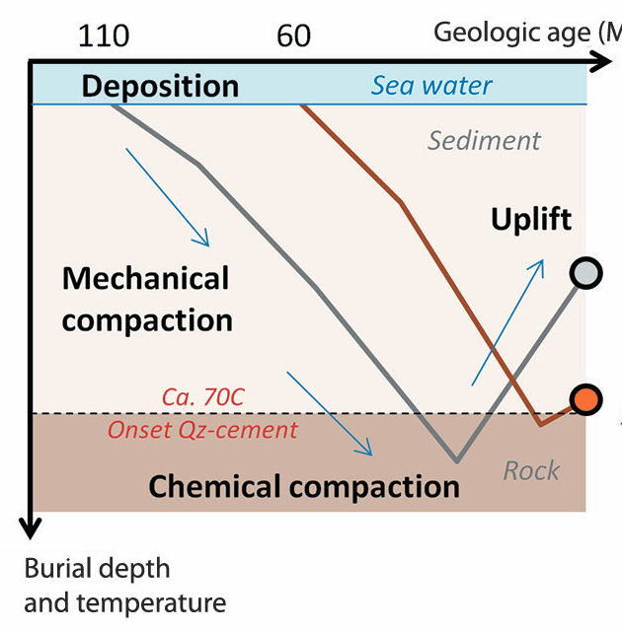
Compaction
Bjørlykke (2014).
Avseth, Lehocki, (2016).
Notes:
Compaction: Driving force in determining rock properties.
LEFT:
Explain plot and axes: Porosity (density, velocity), Depth (Stress, Temp)
Processes: Deposition, Burial, Mechanical Compaction, Chemical Compaction
RIGHT:
Uplift
Fig. 3. Principal aspects of siliceous sediment compaction during burial in sedimentary basins. The porosity loss due to mechanical compaction is controlled by the effective overburden
stress and the primary sediment composition, which is a function of the depositional environment and the provenance. If the grain-size distribution and the mineralogy can be predicted
based on facies analyses, the rate of compaction can be predicted. Overpressure reducing the effective stress will preserve more porosity during mechanical compaction. At higher
temperatures chemical compaction involving silicate mineral reactions is a function of mineralogy, temperature and time. The porosity/depth ratio is higher when the sedimentation
(subsidence) rate is high so that the time factor is reduced.

Slide 16
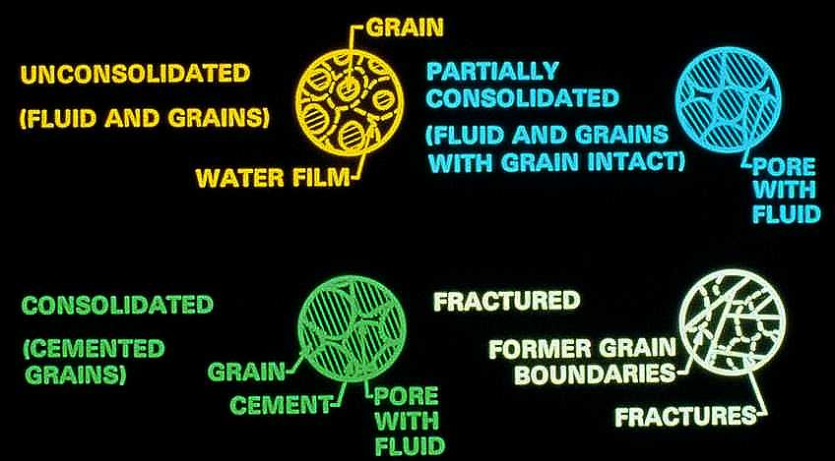
What’s Going on During Compaction
Rock Framework Control Velocity, Density
Porosity decreases, rigidity increases with compaction
Velocity, Density increase with consolidation & cementation
Consolidation, cementation increase with age, depth of burial
Notes:
What’s Going on During Compaction
Rock Framework Control Velocity, Density
Unconsolidated
Partially consolidated: Increased grain to grain contact, rigidity, Cemented, Fractured
Porosity decreases, rigidity increases with compaction
Velocity, Density increase with consolidation & cementation
Consolidation, cementation increase with age, depth of burial

Slide 17
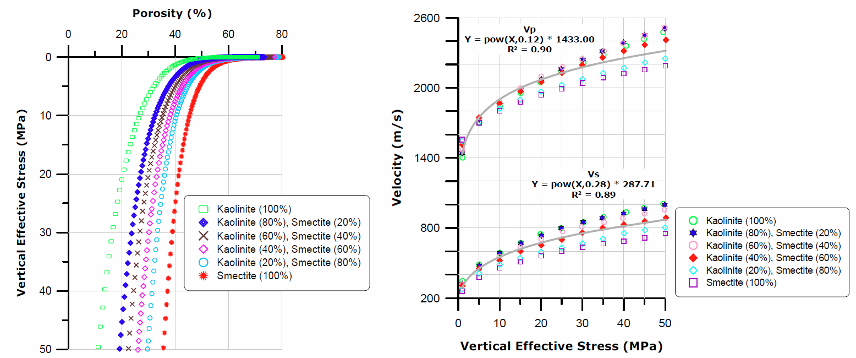
Compaction - Shale
Bjorlykke et al., (2008), Mondol et al., (2007)
Notes:
Compaction – Shale
Mineralogy Dependant
LEFT:
Explain plots: As depth of burial increases, so does vertical effective stress:
Compaction of clays is strongly influenced by the clay mineralogy, pore fluid composition and burial history.
RIGHT:
Softer carbonate grains such as ooids are less compressible because the grain contact becomes relatively large at low to moderate stress
Smectitic clays are less compressible and has lower velocities and permeabilities than kaolinitic clays
Fig. 9. Porosity and velocity versus effective stress of brine-saturated smectite
-kaolinite mixtures (Mondol et al., 2007, Marine & Petroleum Geology).
Compaction of clays is strongly influenced by the clay mineralogy, pore fluid composition and burial history (Fig. 8).
Experimental compaction shows that smectitic clays are less compressible and has lower velocities and permeabilities
than kaolinitic clays (Fig. 9 and 11).
The physical properties of
mudstones vary greatly with depth and mineralogy plays a
significant role to control compaction (Fig. 12, 13 and 14).
The low compressibility of fine grained clays like smectite is
due to the total stress is distributed on a very large number of
clay contacts (Fig. 9). The smectite to illite reaction (Fig. 8)
may produced significant amounts of micro-quartz cement
(Fig. 10), which may have contributed to the increase in
velocity without significantly reducing the porosity or
increasing the density of the mudstones.

Slide 18
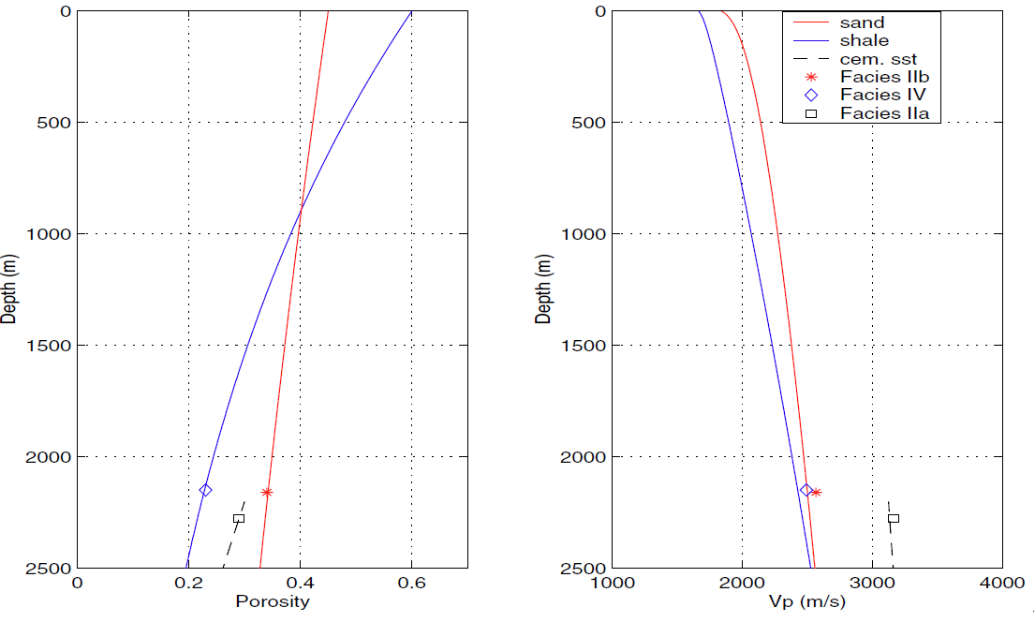
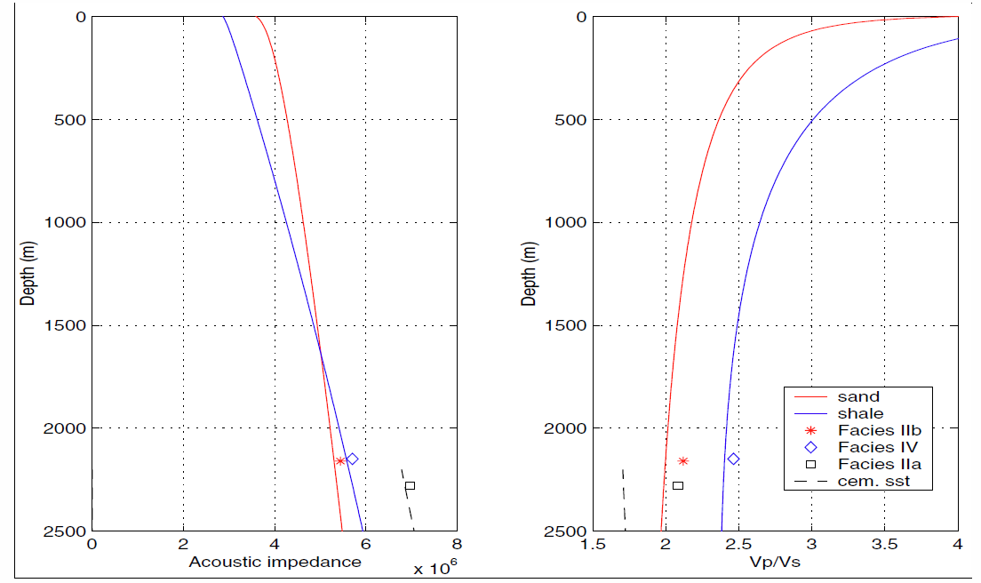
Compaction - North Sea
Glitne Field
Porosity, Vp and Impedance versus depth for unconsolidated sands, shales and cemented sandstone.
cementation increases velocity
cementation reduces porosity (increased density)
cementation increases impedance
cementation increases impedance
Avseth, et. Al. (2001a).
Notes:
Compaction - North Sea, Glitne Field
Pay attention, 2nd 3D interpretation project
Sand and shale trends:
LEFT:
Porosity vs. Depth > Sands, shales, cemented sands, CROSSOVER, cementation reduces porosity.
CENTER:
Velocity vs. Depth > Sands, shales, cemented sands, CROSSOVER below, cementation increases velocity.
RIGHT:
Impedance vs. Depth > Sands, shales, cemented sands, CROSSOVER below, cementation increases impedance.
Chemical processes in shales begin at an intermediate digenetic level (80-140 0C), including transformation of smectite to illite and liberation of organic acids from organic matter. These changes can have a very
significant effect on adjacent sandstones

Slide 19
North Sea Rock Property Data
Forties Field
Porosity, Vp and Impedance versus depth overlain on Glitne Field Trends
Notes:
Porosity, Vp and Impedance versus depth overlain on Glitne Field
Follows trends until ~2280
Shale still roughly on porosity trend, but sands much lower porosity, velocity, impedance.
Something happens here, but what?

Slide 20

Compaction – Hydrocarbon Signature
Oil Sands vs. Depth
DHI Classes
Stacked Seismic Data
Oil
Sand
Class III
Oil
Sand
Class II
Oil
Sand
Impedance
Class I
Notes:
Let’s take a look at an oil sand reservoir and how these factors affect the impedance and the seismic response.
Class III - very unconsolidated sands - high porosity, lower velocity, density than surrounding shales, large contrast (negative on top, positive at base) , high amplitude reflection
Class II - older, more consolidated. Impedance similar to surrounding shales. Little contrast, low amplitude seismic reflection
Note: Shales have increased in impedance, but not as much as sand.
Class III - Very consolidated, older lower porosity. Higher impedance than surounding rocks, moderate contrast and moderate reflection.
Note polarity - we’ll talk a lot about this as we go on.

Slide 21

Compaction – Hydrocarbon Signature
DHI Classes
Stacked Seismic Data
Water Sands vs. Depth
Water
Sand
Class III
Water
Sand
Class II
Water
Sand
Impedance
Class I
Notes:
Overlaid oil, water sand and shale trends
Note Water sand, oil sand crossovers

Slide 22
Compaction – Hydrocarbon Signature
DHI Classes
Stacked Seismic Data
Trends vs. Depth
Sand
Class III
Sand
Depth
Class II
Sand
Impedance
Class I
Notes:
These trends in compaction and the relative difference between hydrocarbon water sands is critical in predicting what type of anomalies, if any, to expect.
Explain plot - Impedance points, shale line, water sand line, oil sand line. very common in assessing the anomaly potential of an area.

Slide 23
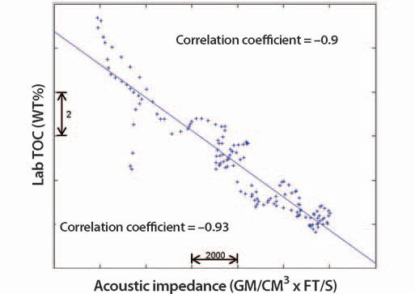
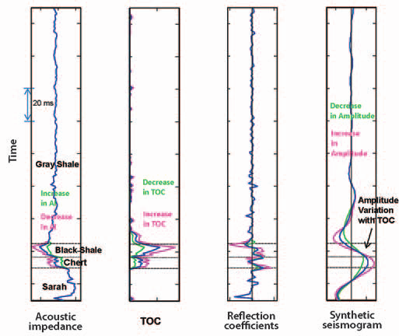
Unconventional Resources - TOC
Impedance vs. Total Organic Content (TOC)
1D Scenario modeling: Varying TOC
Broadhead et al. (2014)
23
Notes:
Impedance vs. Total Organic Content (TOC)
LEFT:
Explain plot, Significance in unconventional resource plays
RIGHT:
1D Scenario modeling
ID Plots
Note wavelet, tuning thickness

Slide 24
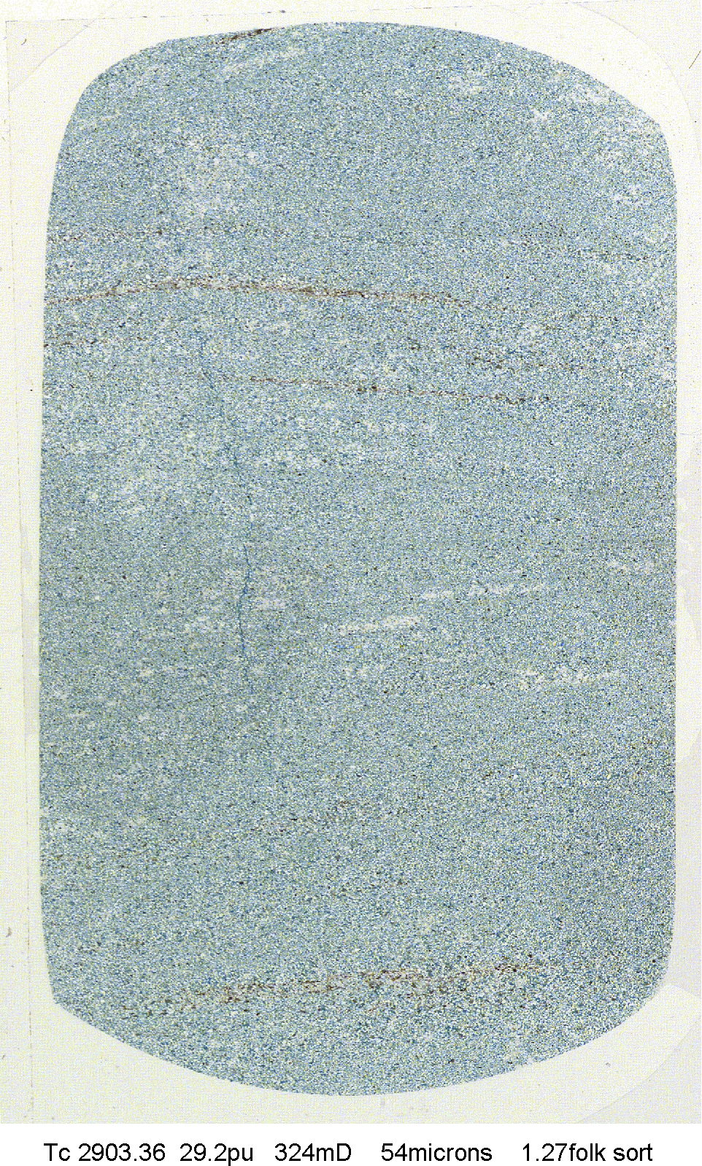
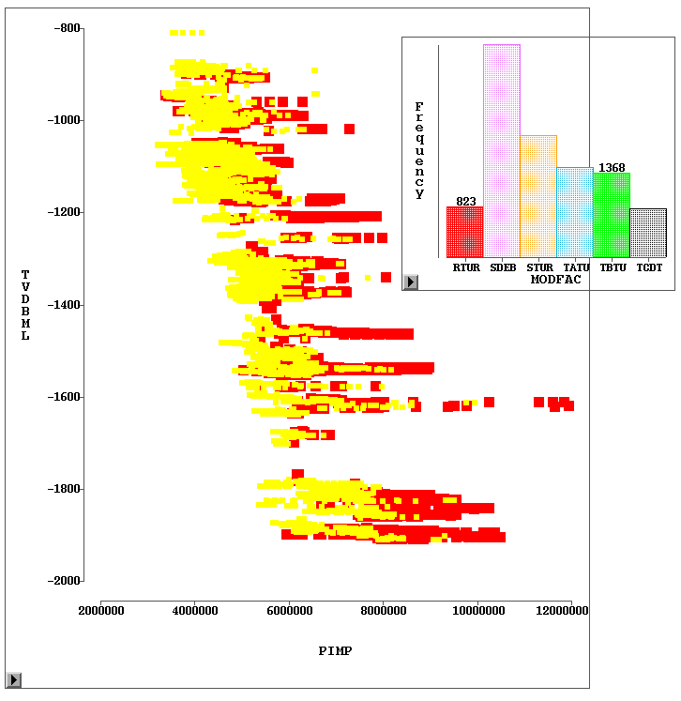
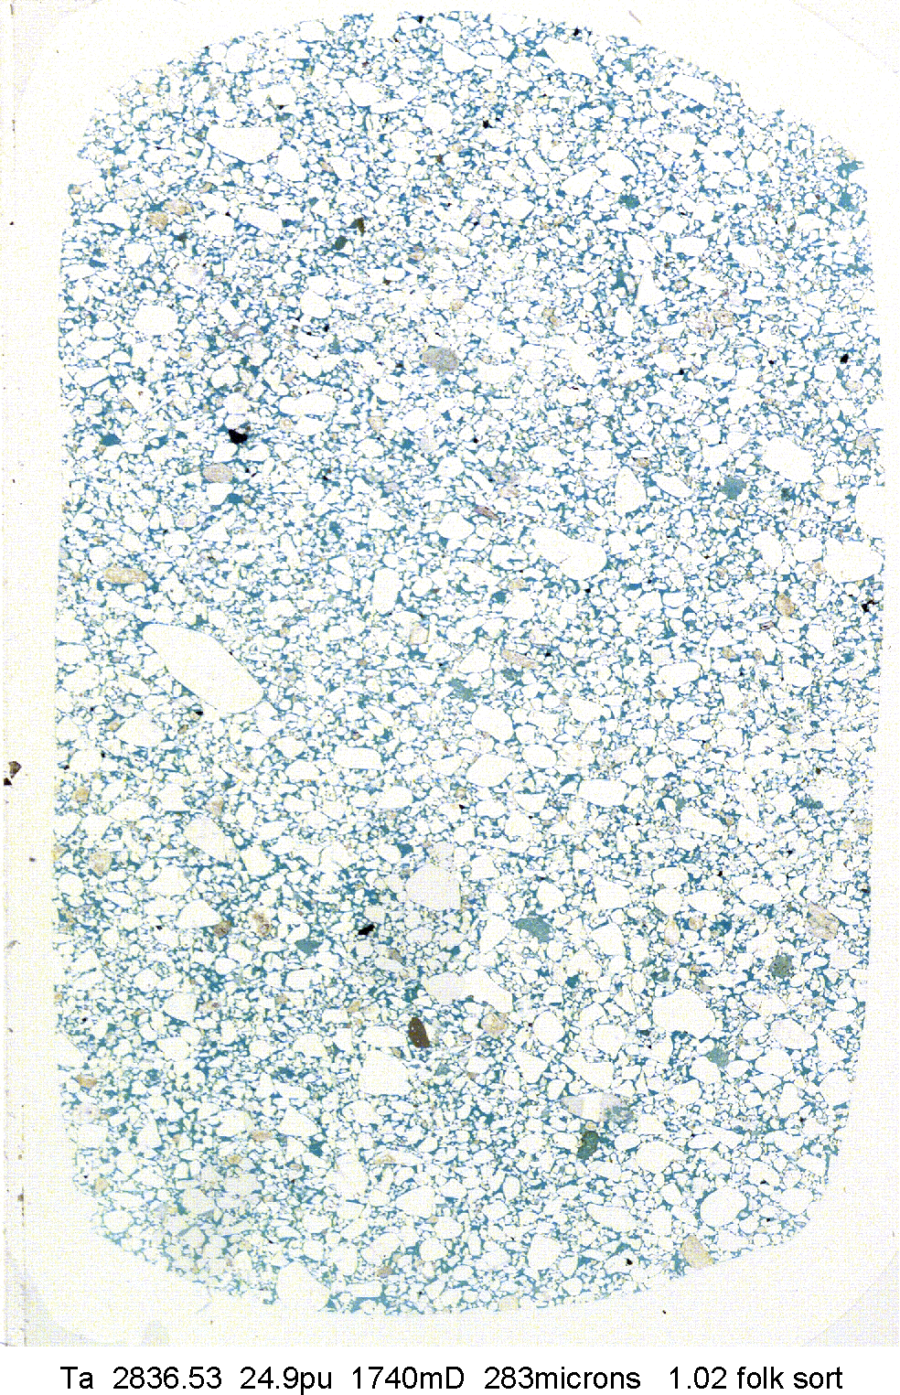
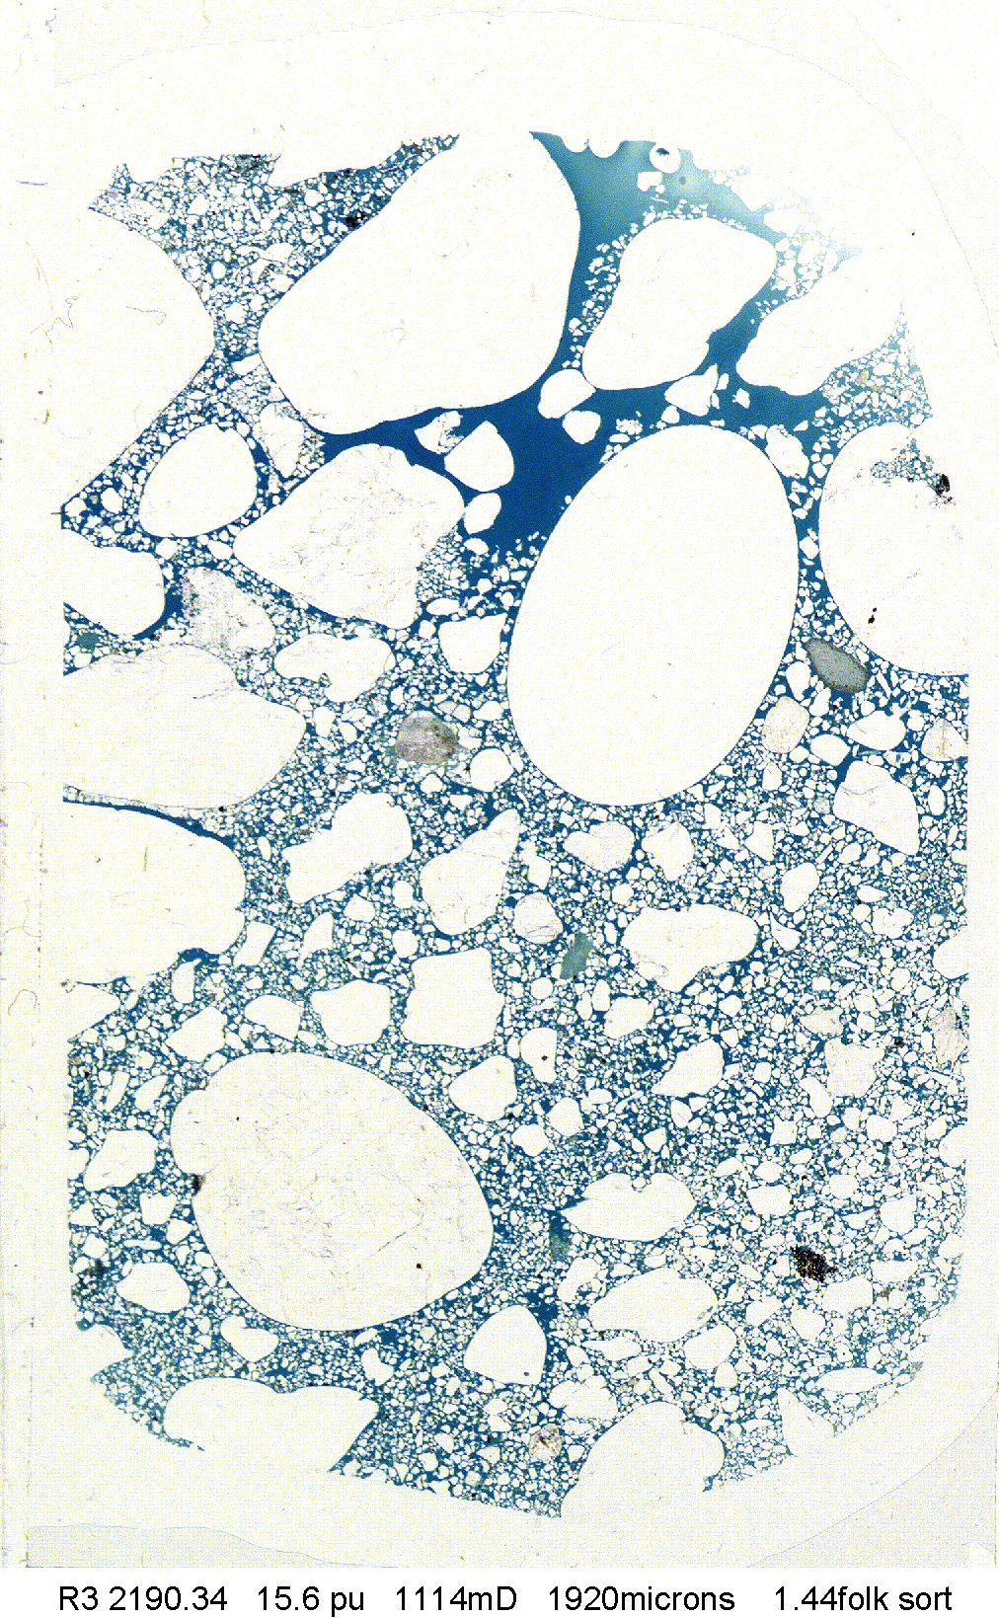
Sorting
Impedance vs. Burial Depth
High Porosity, Low Impedance Sands
800
Moderately Well Sorted Suspension Turbidites and Sandy Debrites
1000
Traction Turbidites
Ta
Tc
1200
1400
TVD BML (m)
High Porosity, Low Impedance Sands and
Low Porosity, Mixed-High Impedance Sands
1600
Sandy Turbidites/ Debrites
Poorly Sorted
Traction Turbidites
1800
2000
Shale Trend
R
2E06
4E06
6E06
8E06
1E07
Impedance
Notes:
Explain elements
Note rock types, very different compaction curves. Shale line.
Point out low impedance, high impedance sands

Slide 25
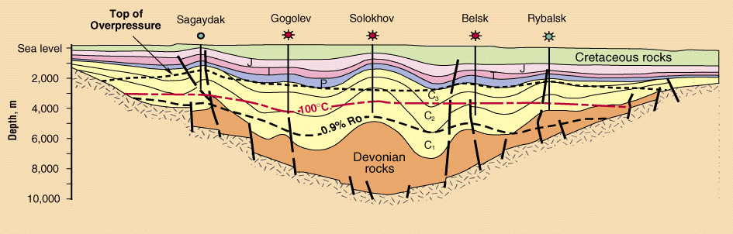
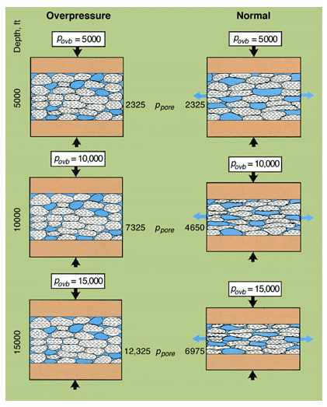
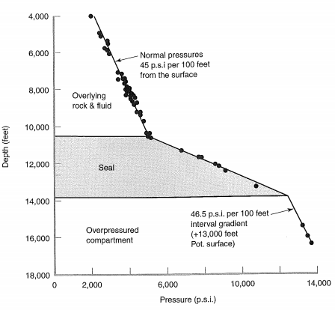
Overpressure
Deming, (2001).
Notes:
Overpressure
TOP LEFT:
Fast deposition, low perm layers, prevent compaction
BOTTOM LEFT:
Depth vs. pressure
Normal, Seal, Overpressured
RIGHT:
Comparison of normal, overpressured rocks
Increasing pressure > nowhere for water to go.
Point out overburden, pore pressure

Slide 26
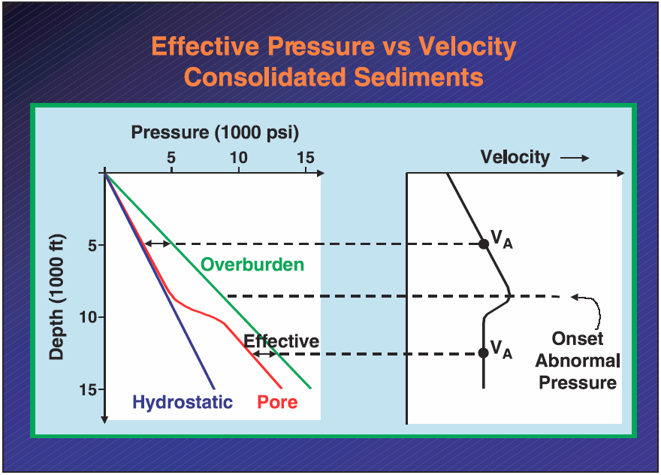
Overpressure
Increasing pore pressure softens the elastic mineral frame by opening cracks and flaws.
tends to lower velocities
Changing pore pressure can change the saturation as gas goes in and out of solution.
velocities can be sensitive to saturation
High pore pressure over long periods of time can inhibit diagenesis and preserve porosity.
keeps velocities low
Notes:
LEFT: Read
RIGHT:
Explain graphs, point out where seal is

Slide 27
Fluid Properties
Reservoir Properties
Temperature
Pressure
Fluid Properties
Fluid Type
API Gravity
GOR
Saturation
Fluid Density
Viscosity
Brine Salinity
Notes:
Impedance is also controlled by the fluids that are in the pore spaces. Obviously this is of great interest to us looking at DHI/AVO anomalies.
What we care about is how different are the properties of hydrocarbons and water. The greater the difference, the greater the change in reflection amplitude.
EXPLAIN SLIDE

Slide 28
Empirical Gas Property Relations
P Velocity, Density = f (Pressure, Temperature)
Velocity
Density
Pressure
Temperature

Slide 29
Empirical Oil Property Relations
Velocity, Density = f (Pressure, Temperature, API, GOR)
API gravity = oil density = f (composition)
GOR (reservoir fluid) = dissolved gas volume / oil volume
Velocity
Density
Pressure
Temperature
API
GOR
API =141.5/ ρ_{O} −131.5

Slide 30
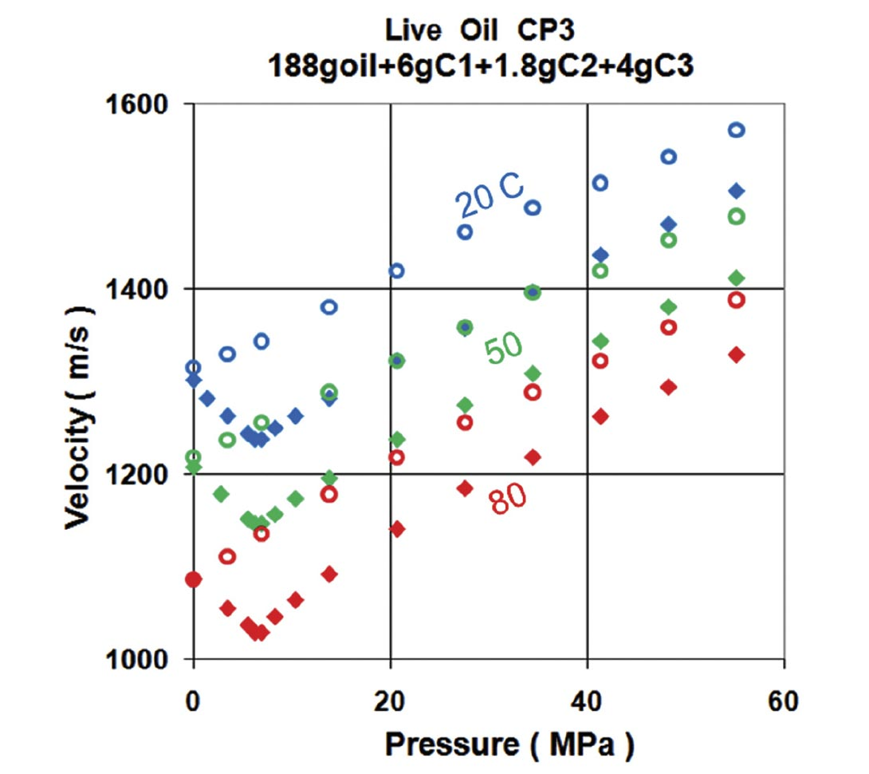
Oil Properties – Temperature and Pressure
Velocity of a light oil as a function of pressure and temperature.
“It’s the Fluids that Count” Mike Batzle, 2010
Increasing pressure increases velocity
Increasing temperature decreases velocity.
The velocity of “live” (open symbols) oil with gas in solution is much lower than for “dead” (solid symbols) oil with no gas in solution.
Batzle, (2010).

Slide 31
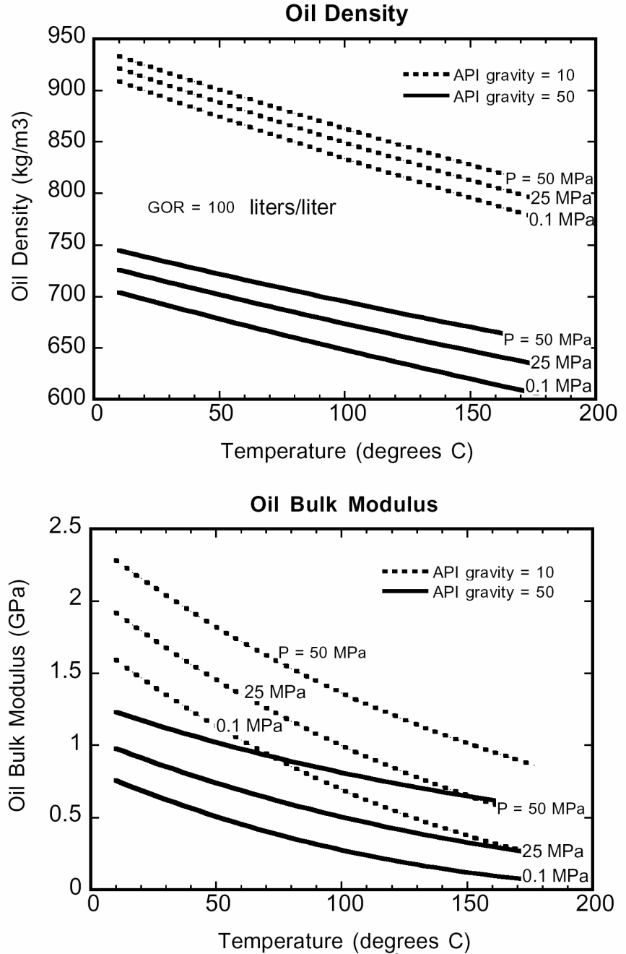
Oil Properties – API Gravity, GOR
31

Slide 32
Empirical Brine Property Relations
Velocity, Density = f (Pressure, Temperature, Salinity)
Velocity
Density
Pressure
Temperature
Salinity

Slide 33
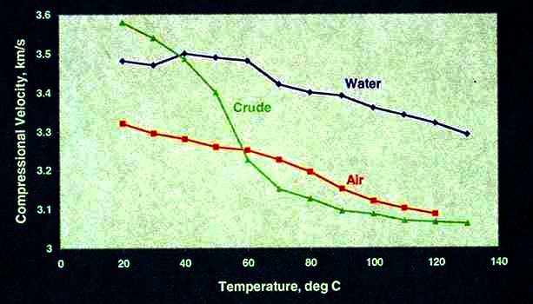
Fluid Type & Temperature
Effect of Temperature, Composition on V_{p}
Properties of gas, oil, and brine vary systematically with fluid composition and reservoir temperature and pressure.
Oil velocity drops rapidly because of dissolved gas
Notes:
EXPLAIN SLIDE
Key Points -
Dramatic change in oil due to dissolved gas - misconceptions in early 80’s due to surface oil measurements
Entire spectrum of hydrocarbons from water to dry gas.

Slide 34
Fluid Effects on Reflectivity
Example of a flat spot, on time-migrated data. This image suggests that the seismic data are zero phase
Herron, (2011).
Notes:
Example of a well-imaged seismic flat spot, denoted by the yellow
arrow, on time-migrated data. This image suggests that the seismic data are zero
phase

Slide 35
Fluid Effects – 4D
Monitor Survey
Baseline Survey
M-B
Gas
Sand
-
=
Oil
Sand
-
+
Water
Sand
-
=
Impedance

Slide 36
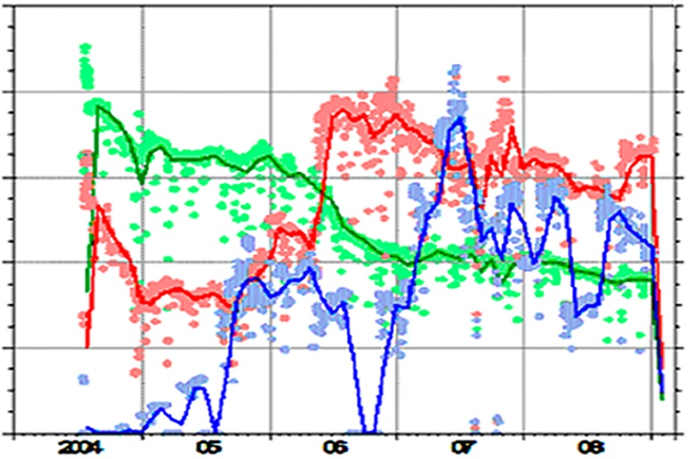
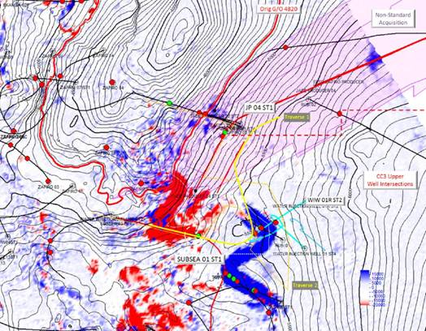
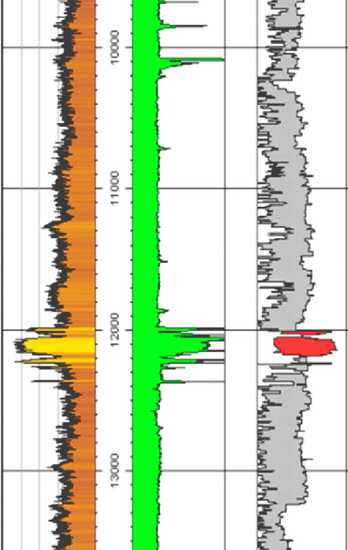
Fluid Effects on Reflectivity
Oil Production
Gas Production
Water Injection
Offshore Clastic Play
Nested Submarine Channel Systems
Monitor – Base
4D Maximum Magnitude Map
Gas Cap
Baseline Survey
Time (Years)
Monitor Survey
-
+
GR
Neutron
Density
Restivity
Potential Interval
Oil
Producer
Water
Injectors

Slide 37
Pitfalls - Oil vs. Gas and the Interdependence of Rock Properties
Notes:
One of the most important things to remember is that the impedance and reflectivity is controlled by many factors, not just the one your interested in (fluid, sand % ...)

Slide 38
Pitfalls
Dependence of Velocity on Gas Saturation, Compaction
10000
9000
Z = 10,000 feet
8000
Z = 6000 feet
7000
Velocity (ft/sec)
6000
5000
Z = 2000 feet
4000
3000
2000
100
80
60
40
20
0
Gas Saturation (%)
Notes:
This illustrates the behavior of gas sands as a function of gas saturation and compaction.
DEEPER = FASTER - less change with faster rocks.
MAJOR Change from 0-5% saturation
DENSITY change is linear.

Slide 39
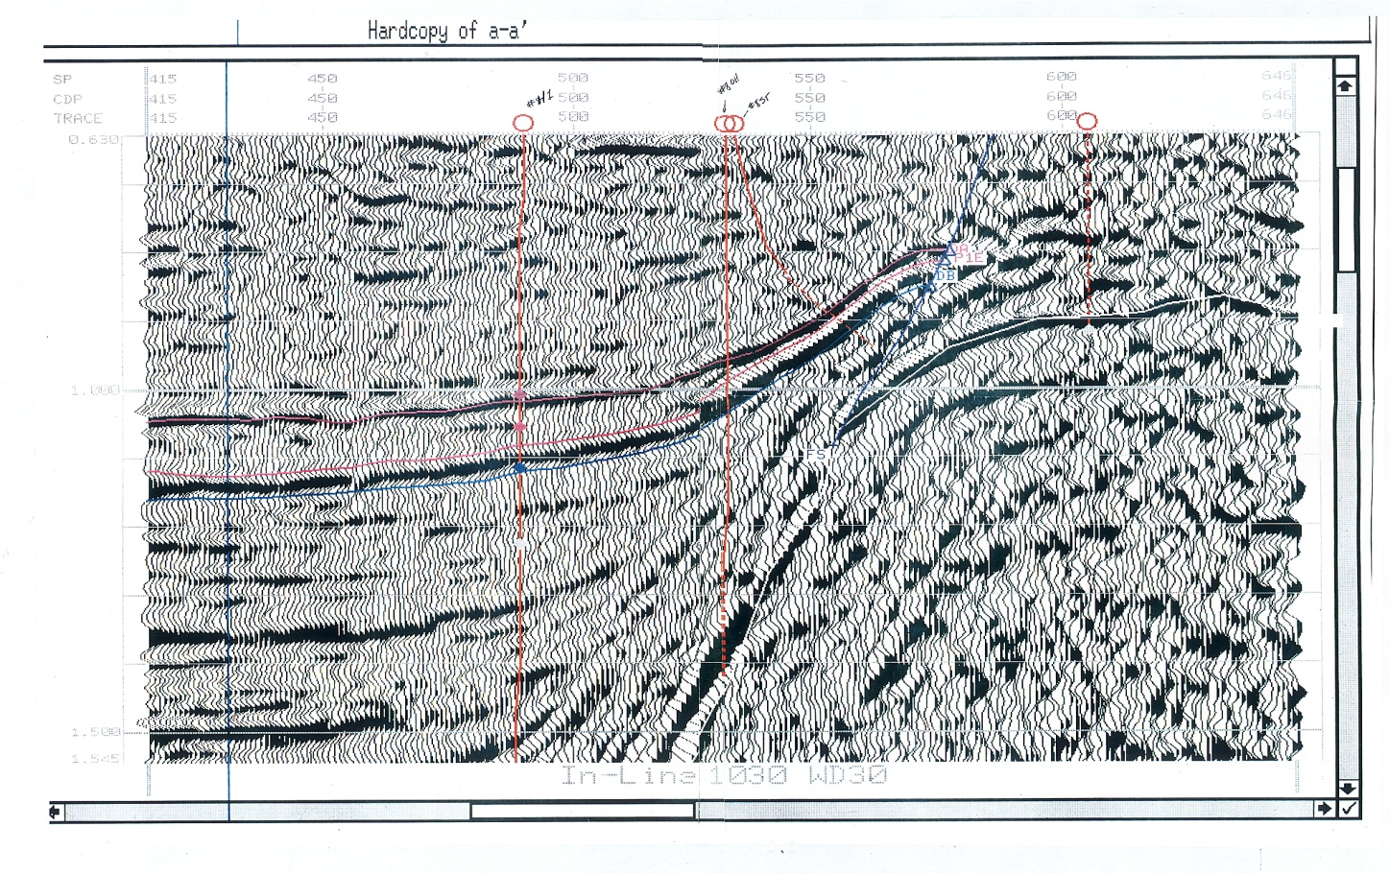
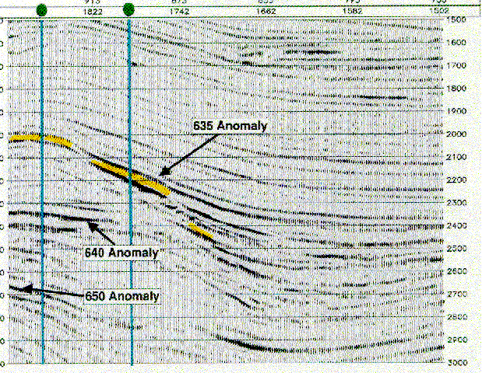
Pitfalls – Low Gas Saturation
Effects of Fluid Saturation
Low Gas GOM Example
Light Oil WAF Example

Slide 40
Pitfalls – Uncertainty
2750
3000
3250
3500
Depth (m)
20000 30000
Impedance

Slide 41
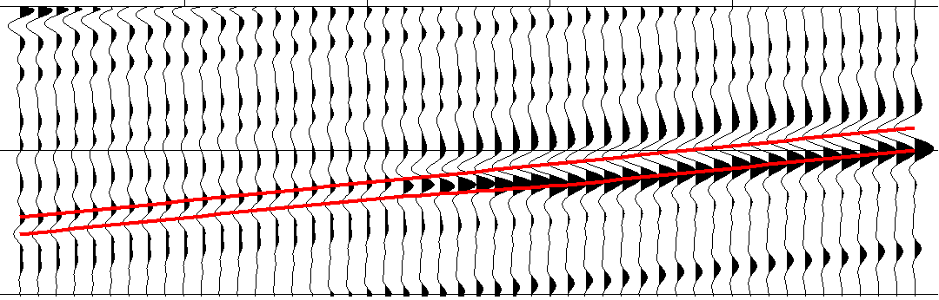
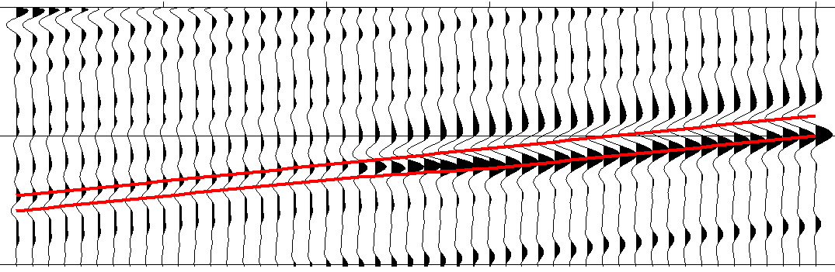
Pitfalls – Uncertainty
Oil amplitudes with higher porosity are equivalent to gas amplitudes with lower porosity
Just one example showing that the factors that affect rock properties & seismic amplitudes are not independent.
The more information you have on some properties, the more reliable the prediction of others
ϕ = 25%
oil
ϕ = 23%
gas
Notes:
Explain slide.

Slide 42
Pitfalls – Everything Else
Source Signature
Processing is an attempt to remove geologic and non-geologic affects from the seismic data and preserve information on the primary reflectivity
Long Period
Multiples

Slide 43
Seismic Facies Mapping Exercise

Slide 44
Seismic Facies Mapping Exercise
Orange
Datum
Schroeder, (2006) Courtesy of ExxonMobil
Notes:
Credit Fred, Exxon
You will be doing a simple seismic facies mapping exercise
This seismic line has been flattened (datumed) on the green horizon
This removes post-depositional tilting
Our interest is at the orange horizon
We want to determine where there is good reservoir rocks below the orange horizon with good seal rock just above it

Slide 45
Seismic Facies Mapping Exercise
Conceptual Depositional Model:
Stacked, prograding fluvial to nearshore to offshore siliciclastic parasequences
Magenta
Orange
Fluvial
shales - sands
Nearshore
sands
Offshore
shales
Schroeder, (2006) Courtesy of ExxonMobil
Notes:
This is the conceptual model for deposition during the period we are interested in
This area was characterized by nearshore to offshore deposition
Note at the orange horizon
Below the horizon – there are fluvial and nearshore deposits
Above the horizon – there are offshore shale deposits

Slide 46
Seismic Facies Mapping Exercise
Conceptual Depositional Model:
Prograding sands increase in porosity upwards before being capped by variable quality marine shale.
Magenta
Porous Sand (reservoir)
Marine Shale (seal)
Orange
Fluvial (reservoir)
Porous Sand (reservoir)
Marine Shale (seal)
Schroeder, (2006) Courtesy of ExxonMobil
Notes:
At any location:
We could have poor to good reservoir quality (sand vs. silt and shale, reworking by waves, etc)
We could have fair to excellent seal quality (marine shales diluted with some to no silt)

Slide 47
Seismic Facies Mapping Exercise
Scenario Modeling: Varying Seismic Response
Seismic modeling indicates the following response to changes in reservoir and seal quality:
Above-Orange Peak Amplitude
Below-Orange Trough Amplitude
Good Seal
Good Reservoir
Poor Seal
Good Reservoir
Good Seal
Poor Reservoir
Poor Seal
Poor Reservoir
Strong Peak
Strong Trough
Moderate Peak
Strong Trough
Strong Peak
Moderate Trough
Moderate Peak
Moderate Trough
Schroeder, (2006) Courtesy of ExxonMobil
Notes:
Scenario Modeling: Modeled Seismic Response
Some seismic models were generated for this area
The pulse is called quadrature phase – similar to a minimum phase response
The orange horizon occurs at a zero-crossing
Attribute of the peak above the orange horizon indicate the properties of the seal
Attribute of the trough below the orange horizon indicate the properties of the reservoir
a strong (high positive amplitude) peak over a strong (high negative amplitude) trough is what we want to find
if the peak (trough) is moderate or low amplitude, it indicates less favorable seal (reservoir)

Slide 48
Seismic Facies Mapping Exercise
Objective:
Identify areas where good-quality seal rocks overlay good-quality reservoir rocks
Available data / tools:
Seismic attribute maps
Orange time structure map
Depositional model and seismic response
Tracing paper
Notes:
Slide 25
So the objective of the exercise is to identify areas where good-quality seal rocks overlay good-quality reservoir rocks
You are given:
Two seismic attribute maps
Orange time structure map
Depositional model and seismic response
Tracing paper and pencils

Slide 49
Backup & References

Slide 50
Relations between seismic properties and rock properties
Compaction Better-compacted rocks have higher seismic properties (compressional and shear velocities and impedances) because of better connectivity/contact.
Consolidation Better-consolidated rocks have higher seismic properties because of better connectivity/contact.
Age Older rocks have higher seismic properties because of better compaction.
Cementation Cemented rocks have higher seismic properties because of better connectivity and contacts among grains.
Texture Texture includes grain size, sorting, roundness, etc. In general, sands with larger grain size and sands with poorly sorted grains have higher seismic properties because of better contacts and lower porosity. Sands with angular grains have lower seismic properties but higher Vp /Vs compared with sands composed of spherical grains.
Clay content The effect of clay on seismic properties depends on the position of the clay particles inside the rock. Statistically, rocks with higher clay content have lower seismic properties and higher Vp /Vs .
Anisotropy Two types of anisotropy exist: intrinsic and induced. Almost all shales are intrinsically anisotropic. A good approximation of shale anisotropy for flat layers is vertical transverse isotropy. Older, consolidated shales usually have higher degrees of seismic anisotropy. Stress anisotropy is the major cause of induced anisotropy. Most reservoir rocks can be approximated being intrinsically isotropic unless they are finely layered.
Fractures : Fractures cause seismic properties to decrease. Compressional properties are affected much more by fractures compared to shear properties when the waves are polarized across the fractures. Waves polarized perpendicular to a fracture have low Vp/Vs . Aligned fractures also cause seismic anisotropy.
Porosity: Statistically, seismic properties decrease as porosity increases. Vp /Vs is normally not a strong function of porosity.
Lithology: Dolomite has high seismic properties, followed by limestone and sand. Shales may have higher or lower seismic properties than sands. Limestone has high Vp /Vs , followed by dolomite and sands. Shales always have higher Vp /Vs than sands. Uncompacted sands may also have high Vp /Vs .
Pore shape: Pore shape is the most important factor influencing seismic properties yet is the hardest to quantify. In general, rocks with flat pores have lower
Wang, (2010).

Slide 51
Relations between seismic properties and rock properties
Viscosity: Rocks with more viscous oil tend to have higher seismic properties. When viscosity is extremely high, the oil may act as a semisolid in the rock, resulting in higher seismic properties.
API Gravity: Higher-density oils have higher bulk moduli (lower compressibility). As a result, rocks with higher-density oils have higher compressional properties and shear impedance, but shear velocity may be lower.
Wettability: Wetting changes the interfacial energy between the rock and the saturating fluid (the interfacial forces are attractive between the wetting fluid and the solid surface and repulsive between a nonwetting fluid and the solid surface). A rock fully saturated with a nonwetting fluid has slightly higher seismic properties compared with the same rock saturated with the same but wetting fluid. Most sands are water wet, so seismic properties decrease when water is added to a dry rock (softening effect).
Fluid composition and type: Heavier oils contain higher carbon-number hydrocarbons so that their bulk moduli are higher. As a result, rocks saturated with heavier oils show higher compressional properties. Shear properties are much less affected, with shear impedance being slightly higher and shear velocity being slightly lower. In general, high-salinity brine has the highest bulk modulus, followed by low-salinity brine, freshwater, oil, and gas. But some heavy oils may have a bulk modulus as high as or even higher than that of water.
Fluid phase Rocks saturated with fluids in their gaseous phase (hydrocarbon gas, steam, CO2 gas) have lower compressional seismic properties and shear impedances but slightly higher shear velocities because of the fluids’ higher compressibility and lower bulk density, resulting in lower Vp/Vs in the rocks. Seismic properties hardly depend on the amount of gas when gas saturation is between 5% and 100%.
Gas-oil and gas-water ratios :The larger the amount of gas dissolved in an oil, the lower the bulk modulus. Some high gas-oil-ratio (GOR) oils act like gas seismically, resulting in “bright spots” at oil-water contacts. Rocks saturated with high GOR oils have lower compressional seismic properties compared to the same rocks saturated with gas-free oils. Gas dissolved in water has little effect on the bulk modulus because of the unique molecular structure of water. Little gas can be dissolved in water anyway.
Saturation: Full saturation of a liquid in a rock increases the compressional seismic properties and shear impedance but decreases Vs, resulting in increases in Vp/Vs . When gas is introduced to a fully liquid-saturated rock, the compressional seismic properties and shear impedance all decrease but Vs increases, resulting in lower Vp/Vs . The magnitude of saturation effect is higher in rocks with weak frames and/or flat pores (cracks, fractures).
Wang, (2010).

Slide 52
References

Slide 53
References

